Slide 1
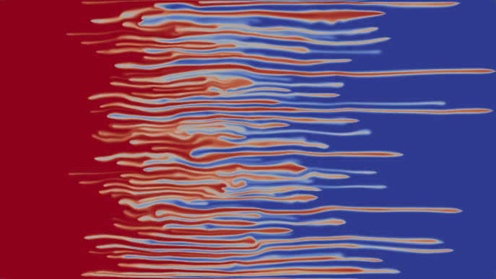



A propagating terrace of two traveling waves in a toy model of Incompressible Porous Medium (IPM) eq
Yulia Petrova PUC-Rio, Rio de Janeiro, Brazil
yulia-petrova.github.io
21 June 2024
Based on joint work:
“Propagating terrace in a two-tubes model of gravitational fingering” 2024 (with S. Tikhomirov, Ya. Efendiev) Submitted. ArXiv: 2401.05981
“Velocity of viscous fingers in miscible displacement: Intermediate concentration” 2024
“Velocity of viscous fingers in miscible displacement: Comparison with analytical models”2022 (with F. Bakharev, A. Enin, S.Matveenko, D.Pavlov, N.Rastegaev, I. Starkov, S.Tikhomirov) JCAM

Slide 2
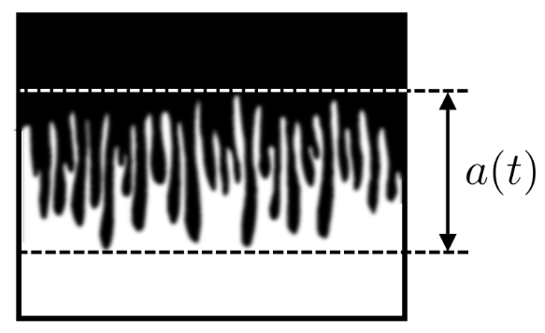
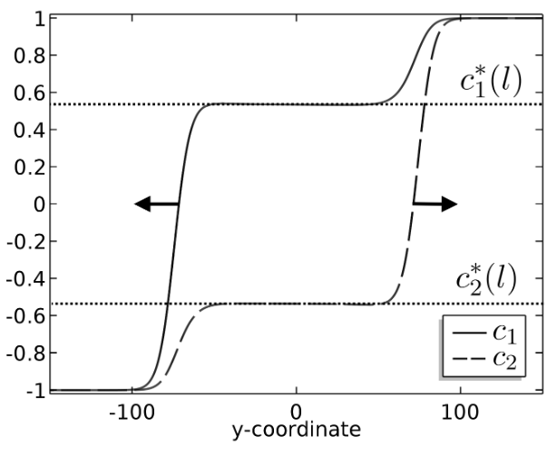
Outline
Motivation
Miscible displacement in porous media
viscous fingering
gravitational fingering
Problem statement
Two-tubes model
Main theorem
Sketch of proof: - traveling waves
- slow-fast systems

Slide 3
“Miscible displacement in porous media”
Credit: Pavlov Dmitrii, St. Petersburg State University
Homsy , 1987 “Viscous Fingering in Porous Media”
Viscous fingering phenomenon
water (blue color) polymerized water (red color)
1

Slide 4
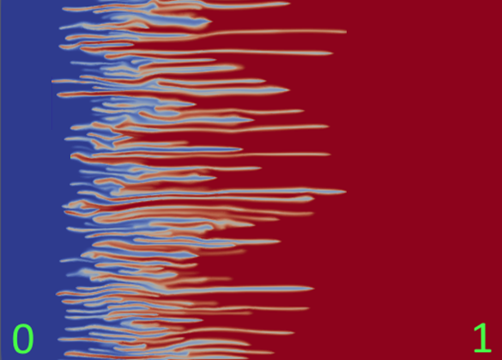
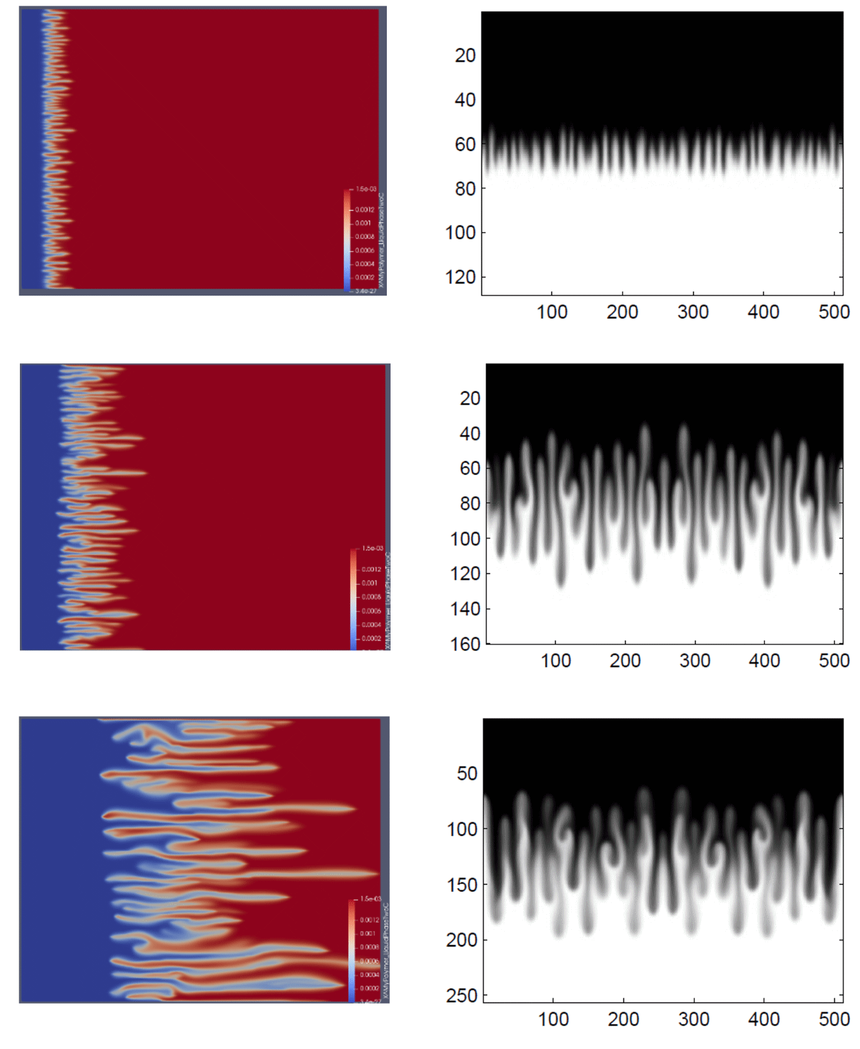
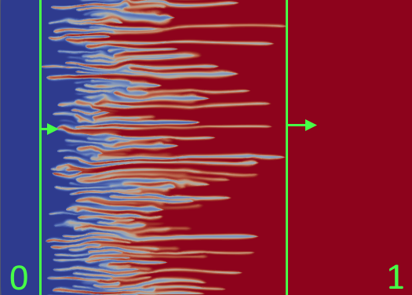
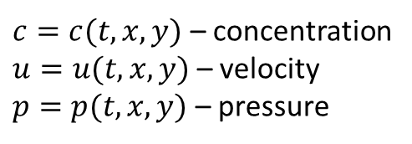
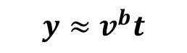
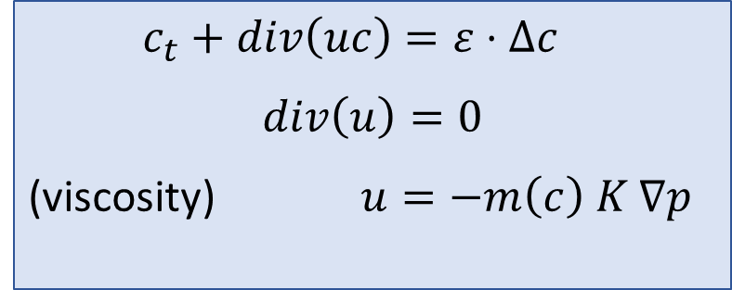



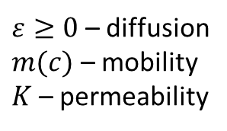
Incompressible Porous Medium eq – IPM, 2D (Two formulations)
Viscous fingering
Gravitational fingering
$c_{t}+div\left(uc\right)=ε⋅Δc$
$$div\left(u\right)=0$$
(viscosity) $u=−m\left(c\right) K ∇p$
1
$$y≈v^{f}t$$
$$x≈v^{b}t$$
$$x≈v^{f}t$$
(gravity) $u=−∇p−(0,c)$
$c=c(t,x,y)$ – concentration
$u=u(t,x,y)$ – velocity
$p=p(t,x,y)$ – pressure
$ε≥0$ – diffusion
$m(c)$ – mobility
$K$ – permeability
-1
$$y≈v^{b}t$$
mixing zone
[1], [2]
many laboratory and numerical experiments show linear growth of the mixing zone
Question: how to find speeds $v^{b}$ and $v^{f}$ of propagation?
[1] Nijjer J., Hewitt D., and Neufeld J. The dynamics of miscible viscous fingering from onset to shutdown. Journal of Fluid Mechanics, 2018.
[2] Bakharev, F., Enin, A., Groman, A., Kalyuzhnyuk, A., Matveenko, S., Petrova, Y., Starkov, I. and Tikhomirov, S., Velocity of viscous fingers in miscible displacement: Comparison with analytical models. Journal of Computational and Applied Mathematics, 2022.
2

Slide 5
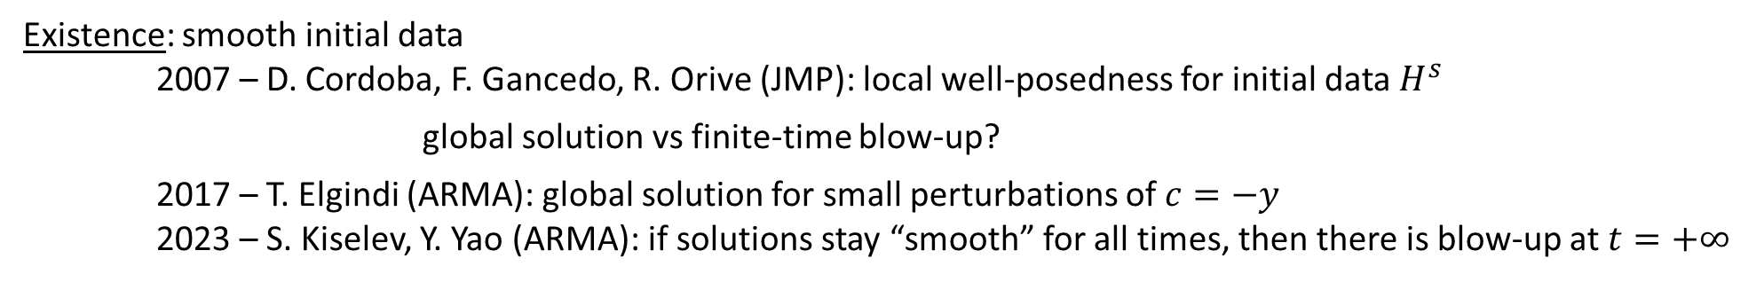
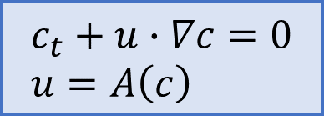
IPM: $ε=0 \text{(}\text{without} \text{diffusion}\text{)}$
$$c_{t}+u∙∇c=0 \\ u=A\left(c\right)$$
Active scalar:
$u=∇^{⊥}{\left(−Δ\right)}^{−1}∂_{1}c$ (Biot-Savart law)
Discontinuous initial data: free boundary problem (Muskat problem) – ill-posed for unstable stratification 2011 - A. Córdoba, D. Córdoba, F. Gancedo (Annals of Mathematics) “Interface evolution: the Hele-Shaw and Muskat problems”
Existence: smooth initial data
2007 – D. Cordoba, F. Gancedo, R. Orive (JMP): local well-posedness for initial data $H^{s}$ global solution vs finite-time blow-up?
2017 – T. Elgindi (ARMA): global solution for small perturbations of $c=−y$
2023 – S. Kiselev, Y. Yao (ARMA): if solutions stay “smooth” for all times, then there is blow-up at $t=+∞$
open
Uniqueness: non-uniqueness of weak solutions – by convex integration
2011 – D. Córdoba, D. Faraco, F. Gancedo (ARMA)
2012 – L. Szekelyhidi Jr.
…and many others…
3

Slide 6
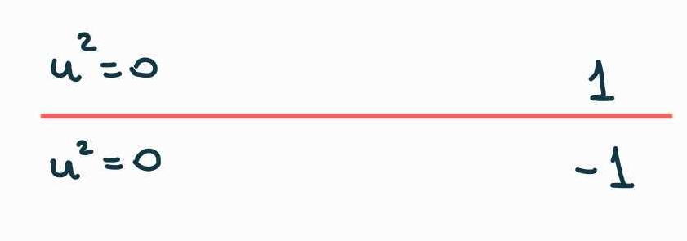
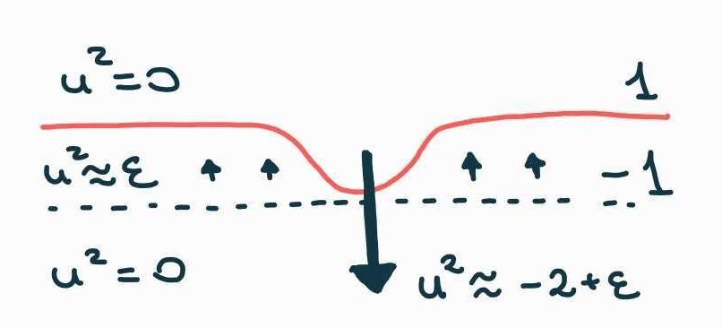
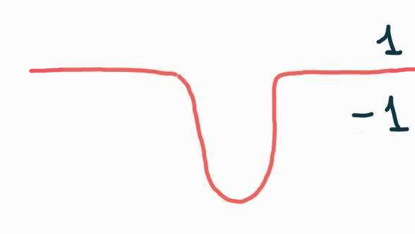
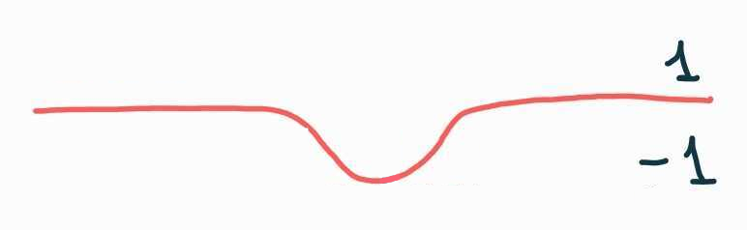
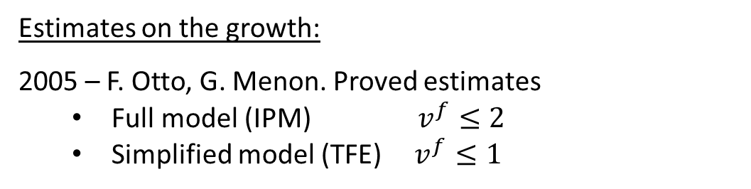
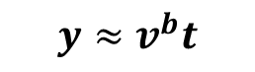
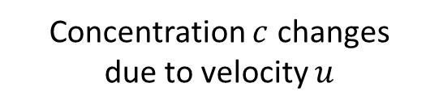
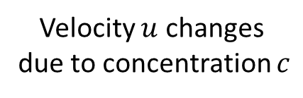

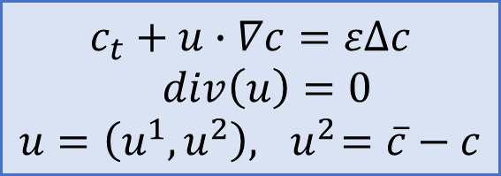
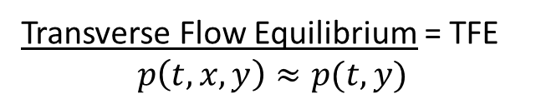
IPM: $ε>0$ (with diffusion)
Estimates on the growth:
2005 – F. Otto, G. Menon. Proved estimates
Full model (IPM) $v^{f}≤2$
Simplified model (TFE) $v^{f}≤1$
1
$$y≈v^{f}t$$
$$c_{t}+u∙∇c=εΔc$$
$div\left(u\right)=0$ $$u=\left(u^{1},u^{2}\right), { u}^{2}=\overline{c}−c$$
Transverse Flow Equilibrium = TFE $$p\left(t,x,y\right)≈p(t,y)$$
-1
$$y≈v^{b}t$$
Why fingers appear? It is a hair-trigger effect!
[2]
Velocity $u$ changes
due to concentration $c$
Concentration $c$ changes
due to velocity $u$
No flow
4
[2] Bakharev, F., Enin, A., Groman, A., Kalyuzhnyuk, A., Matveenko, S., Petrova, Y., Starkov, I. and Tikhomirov, S., Velocity of viscous fingers in miscible displacement: Comparison with analytical models. Journal of Computational and Applied Mathematics, 2022.
[6] Bakharev F., Enin A., Matveenko S., Rastegaev N., Pavlov D., Tikhomirov S. Relation between size of mixing zone and intermediate concentration in
miscible displacement. arXiv:2310.14260
Neglect advection in transverse direction!

Slide 7
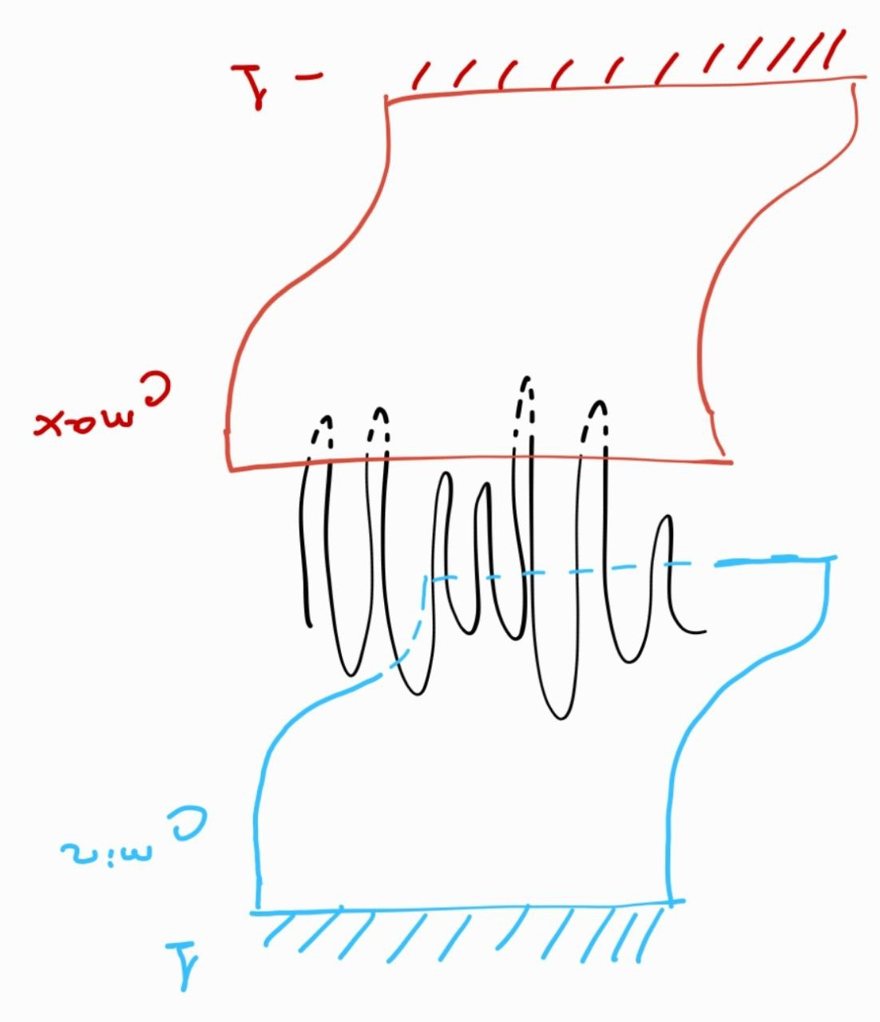
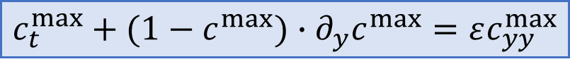
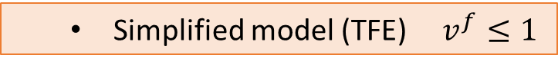
IPM: $ε>0$ (with diffusion)
Estimates on the growth:
2005 – F. Otto, G. Menon. Proved estimates
Full model (IPM) $v^{f}≤2$
Simplified model (TFE) $v^{f}≤1$
1
$$y≈v^{f}t$$
Simplified model (TFE) $v^{f}≤1$
$$c_{t}+u∙∇c=εΔc$$
$div\left(u\right)=0$ $$u=\left(u^{1},u^{2}\right), { u}^{2}=\overline{c}−c$$
Transverse Flow Equilibrium = TFE $$p\left(t,x,y\right)≈p(t,y)$$
-1
$$y≈v^{b}t$$
Idea of proof (TFE): comparison to 1D Burgers eq ($\overline{c}≤1$ then $u^{2}≤1−c$)
[2]
$$c_{t}^{max}+(1−c^{max})∙∂_{y}c^{max}=εc_{yy}^{max}$$
Theorem (Otto, Menon): If $c\left(0,x,y\right)≤c^{max}(0,y)$,
then $c\left(t,x,y\right)≤c^{max}(t,y)$ for any $t>0$.
Question: Are those estimates sharp?
4
[2] Bakharev, F., Enin, A., Groman, A., Kalyuzhnyuk, A., Matveenko, S., Petrova, Y., Starkov, I. and Tikhomirov, S., Velocity of viscous fingers in miscible displacement: Comparison with analytical models. Journal of Computational and Applied Mathematics, 2022.
[6] Bakharev F., Enin A., Matveenko S., Rastegaev N., Pavlov D., Tikhomirov S. Relation between size of mixing zone and intermediate concentration in
miscible displacement. arXiv:2310.14260
Neglect advection in transverse direction!

Slide 8

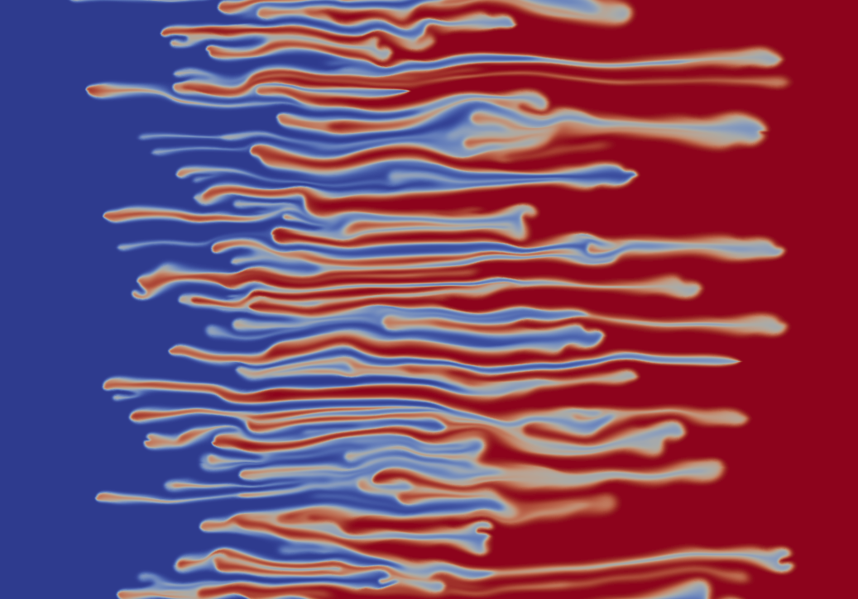
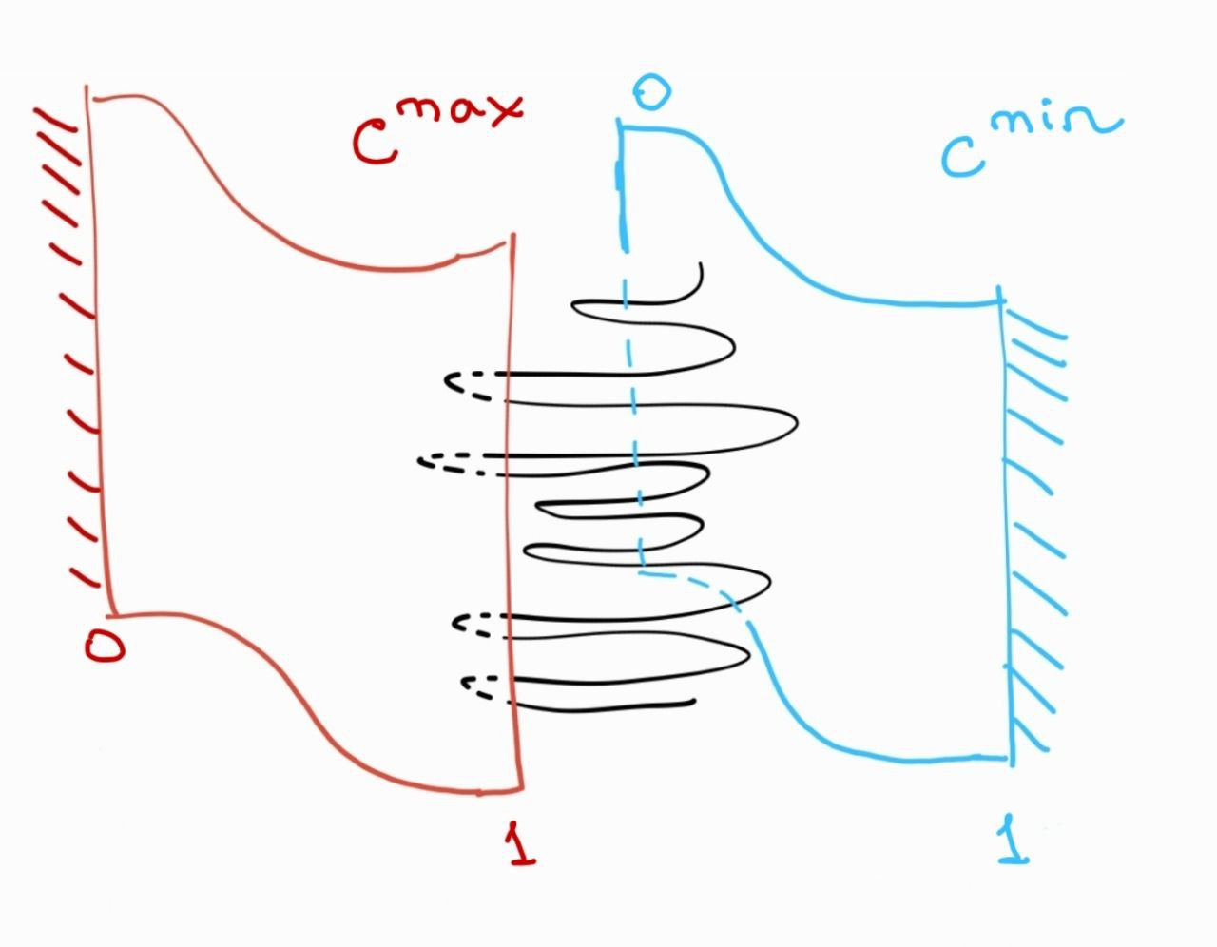
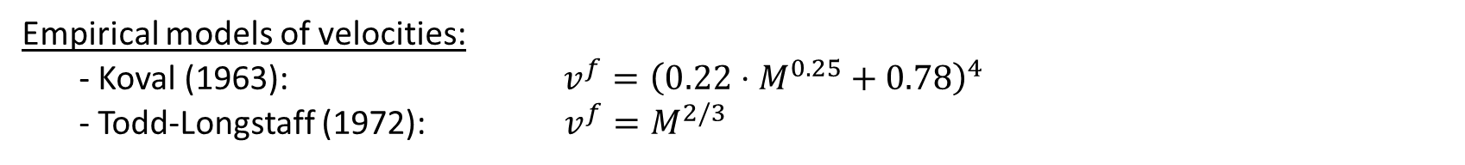
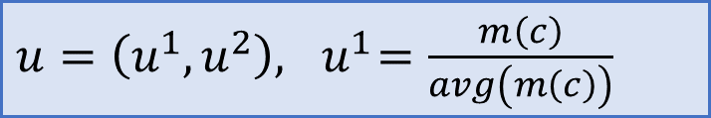
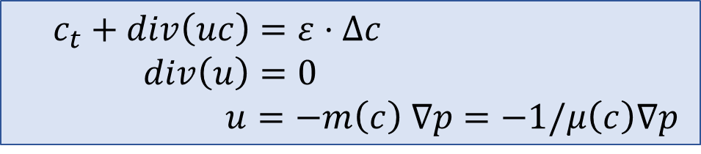
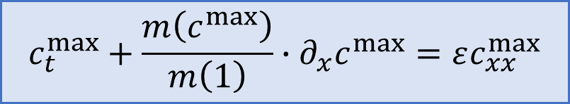
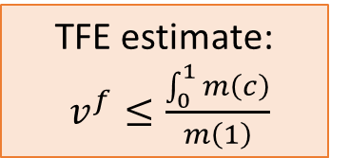
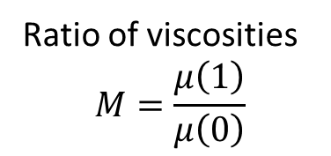
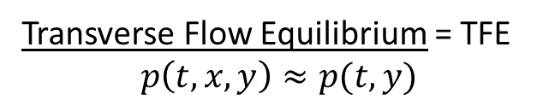
Viscosity-driven fingers
TFE estimates are too pessimistic!
$c_{t}+div\left(uc\right)=ε⋅Δc$
$div\left(u\right)=0$ $u=−m\left(c\right) ∇p=−1/μ\left(c\right)∇p$
Ratio of viscosities
$$M=\frac{μ\left(1\right)}{μ\left(0\right)}$$
Empirical models of velocities:
- Koval (1963): $v^{f}={\left(0.22⋅M^{0.25}+0.78\right)}^{4}$
- Todd-Longstaff (1972): $v^{f}=M^{2/3}$
TFE estimate: $v^{f}≤\frac{\int_{0}^{1}{m\left(c\right)}}{m\left(1\right)}$
Transverse Flow Equilibrium = TFE $$p\left(t,x,y\right)≈p(t,y)$$
$u=\left(u^{1},u^{2}\right), { u}^{1}=\frac{m\left(c\right)}{avg\left(m\left(c\right)\right)}$
Idea of proof (TFE estimates): comparison to 1D Burgers-type eq ($c≤1$ then $u^{1}≤\frac{m\left(c\right)}{m\left(1\right)}$)
$$c_{t}^{max}+\frac{m\left(c^{max}\right)}{m\left(1\right)}∙∂_{x}c^{max}=εc_{xx}^{max}$$
Theorem (Yortsos, Salin, 2006): If $c\left(0,x,y\right)≤c^{max}(0,x)$,
then $c\left(t,x,y\right)≤c^{max}(t,x)$ for any $t>0$.
Question: Are those estimates sharp?
5

Slide 9
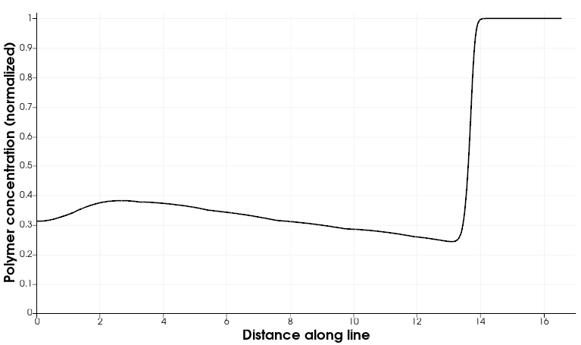
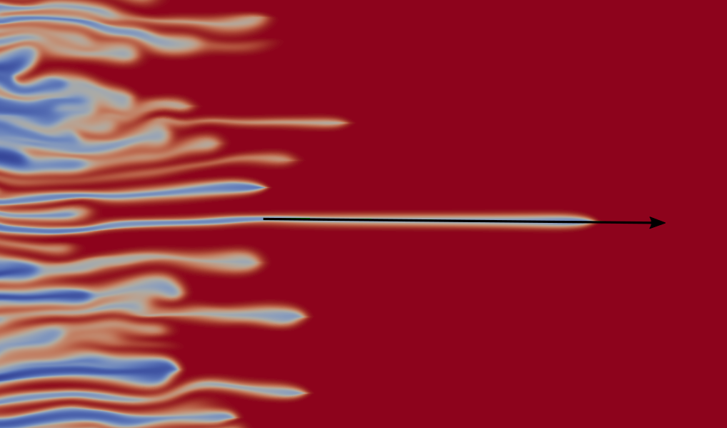
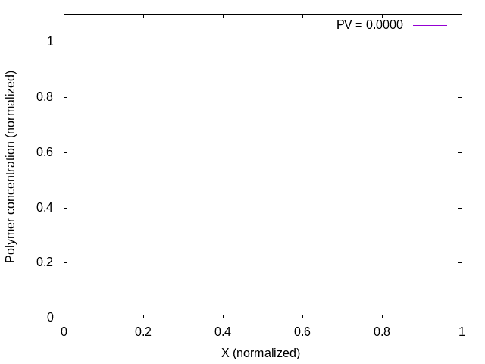
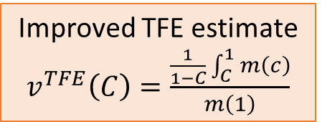
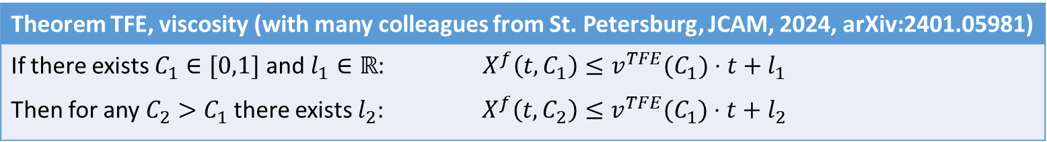
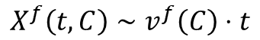
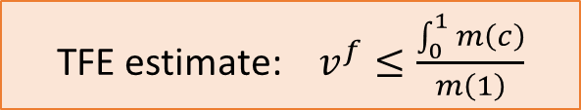
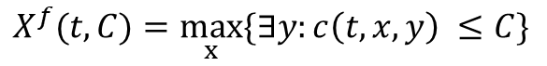
SLOW-DOWN of fingers… Why?
Questions?
Naïve idea: (1) flow in the transverse direction?
$c_{t}+div\left(uc\right)=ε⋅Δc$
$div\left(u\right)=0$ $u=−m\left(c\right) ∇p=−1/μ\left(c\right)∇p$
(2) Intermediate concentration?
A more careful look at simulations….
TFE estimate: $v^{f}≤\frac{\int_{0}^{1}{m\left(c\right)}}{m\left(1\right)}$
Intermediate concentration appears!
Improved TFE estimate $v^{TFE}\left(C\right)=\frac{\frac{1}{1−C}\int_{C}^{1}{m\left(c\right)}}{m\left(1\right)}$
$$X^{f}(t, C)=\max_{x}{\{∃y:c\left(t, x, y\right) ≤C\}}$$
$$X^{f}\left(t, C\right)∼v^{f}\left(C\right)⋅t$$
Theorem TFE, viscosity (with many colleagues from St. Petersburg, JCAM, 2024, arXiv:2401.05981)
If there exists $C_{1}∈[0,1]$ and $l_{1}∈ℝ$: $X^{f}\left(t, C_{1}\right)≤v^{TFE}(C_{1})⋅t+l_{1}$ Then for any $C_{2}>C_{1}$ there exists $l_{2}$: $X^{f}\left(t, C_{2}\right)≤v^{TFE}(C_{1})⋅t+l_{2}$
5
Neglect advection in transverse direction!

Slide 10
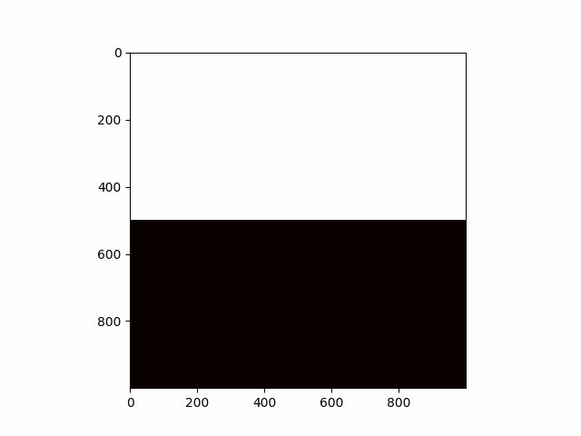
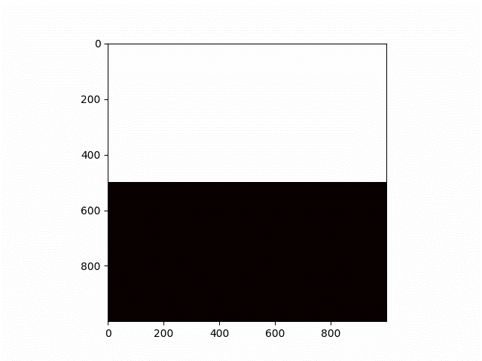
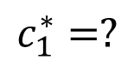
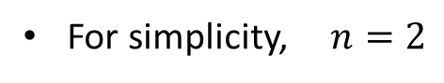
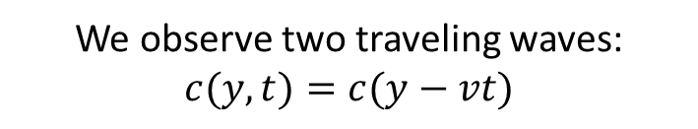
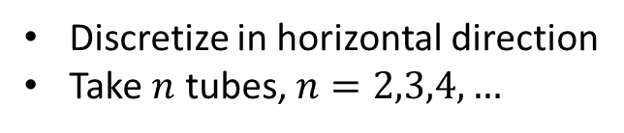
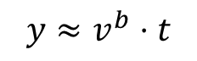
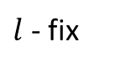



IDEA: semi-discrete model of gravitational fingering
Discretize in horizontal direction
Take $n$ tubes, $n=2,3,4,…$
Limit of
numerical scheme
For simplicity, $n=2$
1
1
$$y≈v^{f}⋅t$$
$$h→0$$
$$c_{1}^{∗}=?$$
$$c_{2}^{∗}=?$$
$$y≈v^{b}⋅t$$
-1
-1
$l$ - fix
Finite volume
Upwind
We observe two traveling waves: $c(y,t)=c(y−vt)$
Tubes (layer, lane,…) models:
2019 — A. Armiti-Juber, C. Rohde “On Darcy- and Brinkman-type models for two-phase flow in asympt. flat domains”
2006 — J.C. Da Mota, S. Schecter “Combustion fronts in a porous medium with two layers”
2019 — H. Holden, N. Risebro “Models for dense multilane vehicular traffic”
6
2005 – Otto, Menon: pointwise estimates for simplified model

Slide 11























Two-tubes model
Original equation on $c:$
Two-tubes equations on $c$:
$$y$$
$$c_{t}+div\left(uc\right)− ∆c=0$$
$$c_{1}(y, t)$$
$$c_{2}(y, t)$$
$$B$$
$$∂_{t}c_{1}+∂_{y}\left(u_{1}c_{1}\right)−∂_{yy}c_{1}=−B$$
$$∂_{t}c_{2}+∂_{y}\left(u_{2}c_{2}\right)−∂_{yy}c_{2}=+B$$
$$u_{1}(y, t)$$
$$w(y, t)$$
$$u_{2}(y, t)$$
Original equation on $p:$
Two-tubes equations on $p$:
$$u=−∇p −(0,c)$$
$$p_{1}(y, t)$$
$$p_{2}(y, t)$$
$$u_{1}=−∂_{y}p_{1}−c_{1}$$
$$u_{2}=−∂_{y}p_{2}−c_{2}$$
$l$ - parameter
$$w=−\frac{p_{2}−p_{1}}{l}$$
$$B=\left\{\left.\begin{aligned}\frac{w}{l}⋅c_{1}, w>0, \\ \frac{w}{l}⋅c_{2}, w<0\end{aligned}\right.\right.$$
Original equation on $u$:
Two-tubes equations on $u$:
$$div(u)=0$$
$$∂_{y}u_{1}+\frac{w}{l}=0$$
7

Slide 12

Two-tubes model
Original equation on $c:$
Two-tubes equations on $c$:
$$y$$
$$c_{t}+div\left(uc\right)− ∆c=0$$
$$c_{1}(y, t)$$
$$c_{2}(y, t)$$
$$B$$
$$∂_{t}c_{1}+∂_{y}\left(u_{1}c_{1}\right)−∂_{yy}c_{1}=−B$$
$$∂_{t}c_{2}+∂_{y}\left(u_{2}c_{2}\right)−∂_{yy}c_{2}=+B$$
$$u_{1}(y, t)$$
$$w(y, t)$$
$$u_{2}(y, t)$$
Original equation on $p:$
Two-tubes equations on $p$:
$$u=−∇p −(0,c)$$
$$p_{1}(y, t)$$
$$p_{2}(y, t)$$
$$u_{1}=−∂_{y}p_{1}−c_{1}$$
$$u_{2}=−∂_{y}p_{2}−c_{2}$$
$l$ - parameter
$$\frac{w}{l}=−\frac{p_{2}−p_{1}}{l^{2}}$$
$$B=\left\{\left.\begin{aligned}\frac{w}{l}⋅c_{1}, w>0, \\ \frac{w}{l}⋅c_{2}, w<0\end{aligned}\right.\right.$$
Original equation on $u$:
Two-tubes equations on $u$:
$$div(u)=0$$
$$∂_{y}u_{1}+\frac{w}{l}=0$$
7

Slide 13




















Main result
The proof is valid only for $l>0$ sufficiently small
Numerics suggests the same statement for $∀l>0$
Moreover, $\lim_{l→0}{c_{1}^{∗}(l)}=−\frac{1}{2}, \lim_{l→0}{c_{2}^{∗}(l)}=\frac{1}{2}$, $\lim_{l→0}{v^{b}(l)}=−\frac{1}{4}, \lim_{l→0}{v^{f}(l)}=\frac{1}{4}.$
Questions?
$$∂_{t}c_{1}+∂_{y}\left(u_{1}c_{1}\right)− ∂_{yy}c_{1}=−B$$
$$∂_{t}c_{2}+∂_{y}\left(u_{2}c_{2}\right)− ∂_{yy}c_{2}= B$$
$$B=\left\{\left.\begin{aligned}−∂_{y}u_{1}⋅c_{1}, ∂_{y}u_{1}<0, \\ +∂_{y}u_{2}⋅c_{2}, ∂_{y}u_{1}>0\end{aligned}\right.\right.$$
($∗$)
$$u_{1}=−∂_{y}p_{1}−c_{1}$$
Remark:
$$\lim_{l→0}{c_{1}^{∗}\left(l\right)=−0.5}$$
$$\lim_{l→0}{c_{2}^{∗}\left(l\right)=+0.5}$$
$$\lim_{l→0}{v^{b}\left(l\right)=−0.25}$$
$$\lim_{l→0}{v^{f}\left(l\right)=+0.25}$$
$$u_{2}=−∂_{y}p_{2}−c_{2}$$
$$∂_{y}u_{1}=−∂_{y}u_{2}=\frac{p_{2}−p_{1}}{l^{2}}$$
As $t→∞$ we observe:
Theorem (Efendiev, P., Tikhomirov, 2024, arXiv: 2401.05981)
Consider a two-tube model with gravity $(∗)$.
$$1$$
$$c_{2}^{∗}(l)$$
there exists $c_{1}^{∗}(l), c_{2}^{∗}(l)$
$c_{1}$ - blue
$c_{2}$ - green
Then for all $l>0$ sufficiently small
such that there exist two traveling waves (TW):
$$c_{1}^{∗}(l)$$
TW1 with speed $v^{b}(l)$: $\left(−1, −1\right) → \left(c_{1}^{∗},(l) c_{2}^{∗}(l)\right)$ TW2 with speed $v^{f}\left(l\right)$: $\left(c_{1}^{∗},(l) c_{2}^{∗}(l)\right) → \left(1, 1\right).$
$$−1$$
8

Slide 14




Many tubes: numerics
The proof is valid only for $l>0$ sufficiently small
Numerics suggests the same statement for $∀l>0$
Moreover, $\lim_{l→0}{c_{1}^{∗}(l)}=−\frac{1}{2}, \lim_{l→0}{c_{2}^{∗}(l)}=\frac{1}{2}$, $\lim_{l→0}{v^{b}(l)}=−\frac{1}{4}, \lim_{l→0}{v^{f}(l)}=\frac{1}{4}.$
3 tubes
4 tubes
7 tubes
Questions:
(open)
(1) explain the structure of “asymptotic solutions” for $n$ tubes and study their stability
(2) find speed of growth of the mixing zone
(3) understand the behaviour as $n→∞$. Do we approximate 2-dim IPM?
(4) can we repeat this story for the many tubes viscous fingering model?
9

Slide 15










Scheme of proof: step 1
СПАСИБО за внимание! Приезжайте в гости в Рио-де-Жанейро!
System of ODEs in $ℝ^{6}$:
Travelling wave (TW) ansatz with fixed $v$:
$$c_{1}\left(t,y\right)=c_{1}\left(y−vt\right)$$
$$c_{2}\left(t,y\right)=c_{2}\left(y−vt\right)$$
$$u_{1}\left(t,y\right)=u_{1}\left(y−vt\right)$$
$$u_{2}\left(t,y\right)=u_{2} \left(y−vt\right)$$
$$p_{1}\left(t,y\right)=p_{1}\left(y−vt\right)$$
$$p_{2}\left(t,y\right)=p_{2}(y−ct)$$
$$\left\{\begin{aligned} \dot{X}=F_{v}(X,Y) \\ l⋅\dot{Y}=AY−BX\end{aligned}\right.$$
Here:
$X=\left(\begin{aligned}\begin{aligned}c_{1} \\ c_{2} \\ ∂_{ξ}c_{1}\end{aligned} \\ ∂_{ξ}c_{2}\end{aligned}\right)∈ℝ^{4}$, $Y=\left({u_{1} \atop p_{1}−p_{2}}\right)∈ℝ^{2}$
$A=\left(\begin{matrix}0 & 1 \\ 2 & 0\end{matrix}\right)$, $B∈M^{2×4}$, $l≪1$
With condition at $+∞:$
$$c_{1}\left(+∞\right)=1$$
$$c_{2}\left(+∞\right)=1$$
$$u_{1}\left(+∞\right)=0$$
$$u_{2}\left(+∞\right)=0$$
$$\left(p_{1}−p_{2}\right)\left(+∞\right)=0$$
Observation:
for $l→0$this system has a special ``slow-fast’’ structure. Key tool: geometric singular perturbation theory (GSPT) by Fenichel (JDE, 1979)
Aim: $∀v$ $∃$TW
find a heteroclinic orbit $\left(X\left(ξ\right),Y\left(ξ\right)\right), ξ∈ℝ$ such that $\left(X\left(+∞\right), Y\left(+∞\right)\right)=$ given point.
10

Slide 16









Scheme of proof: step 2
1) For each $v^{f}∈ℝ$ we find all points s.t. there exists a TW:
$$\left(c_{1} ,c_{2}\right) → \left(1, 1\right)$$
2) For each $v^{b}∈ℝ$ we find all points s.t. there exists a TW:
$$\left(−1, −1\right)→\left(c_{1} ,c_{2}\right)$$
3) Cross fingers that these two curves intersect
$l=0$ – these curves are just straight lines
$0<l≪1$– perturbation argument
11

Slide 17









But what is a singular limit $l=0?..$
$$∂_{t}c_{1}+∂_{y}\left(u_{1}c_{1}\right)− ∂_{yy}c_{1}=−B$$
$$∂_{t}c_{2}+∂_{y}\left(u_{2}c_{2}\right)− ∂_{yy}c_{2}= B$$
$l=0$corresponds to the
two-tubes TFE equations (**) !!!
($∗∗$)
$$u_{1}=\frac{c_{2}+c_{1}}{2}−c_{1}=\overline{c}−c_{1}$$
$$B=\left\{\left.\begin{aligned}−∂_{y}u_{1}⋅c_{1}, ∂_{y}u_{1}<0, \\ +∂_{y}u_{2}⋅c_{2}, ∂_{y}u_{1}>0\end{aligned}\right.\right.$$
(at closer inspection, no surprise at all)
TFE as a limit of IPM when $\frac{k_{y}}{k_{x}}→∞$? Can we use the connection to prove the linear growth in 2D IPM?
Question:
(open)
2D IPM model
$$c_{t}+u∙∇c= ε ∆c \\ div u=0 \\ u=−\left(\begin{matrix}k_{x} & 0 \\ 0 & k_{y}\end{matrix}\right) ∇p−(0, c)$$
$$\frac{k_{y}}{k_{x}}→∞$$
2D TFE model
$$c_{t}+u∙∇c= ε ∆c \\ div u=0 \\ u=\left(u^{x}, u^{y}\right)$$ $u^{y}= \overline{c}−c$
12

Slide 18








Thanks to my collaborators!
Sergey Tikhomirov
Yalchin Efendiev
Dmitry Pavlov
Nikita Rastegaev
Fedor Bakharev
Aleksandr Enin
Sergey Matveenko
Ivan Starkov
13

Slide 19

Thank you for your attention!
yu.pe.petrova@gmail.com
https://yulia-petrova.github.io/
For more details see arXiv:2401.05981 (two-tubes model)
arXiv:2310.14260 (numerics of viscous fingering)
arXiv:2012.02849 (numerics of viscous fingering)
Any questions, comments and ideas are very welcome!
14

Slide 20
References
Muito obrigada pela atenção!
Own works on the topic of the talk:
Yu. Petrova, S. Tikhomirov, Ya. Efendiev, “Propagating terrace in a two-tubes model of gravitational fingering” Submitted. ArXiv: 2401.05981; 2024.
Bakharev, F., Enin, A., Groman, A., Kalyuzhnyuk, A., Matveenko, S., Petrova, Yu., Starkov, I. and Tikhomirov, S., “Velocity of viscous fingers in miscible displacement: Comparison with analytical models”. Journal of Computational and Applied Mathematics, 402, p.113808; 2022.
Bakharev, F., Pavlov D., Enin, A., Matveenko, S., Petrova, Yu., Rastegaev N., and Tikhomirov, S., “Velocity of viscous fingers in miscible displacement: Intermediate concentration” To appear in Journal of Computational and Applied Mathematics, 2024.
Other references: Dynamics of viscous fingering:
Nijjer J., Hewitt D., and Neufeld J. The dynamics of miscible viscous fingering from onset to shutdown. Journal of Fluid Mechanics 837 (2018): 520-545.
Menon, G. and Otto, F., 2006. Diffusive slowdown in miscible viscous fingering. Communications in Mathematical Sciences, 4(1), pp.267-273.
Menon, G. and Otto, F., 2005. Dynamic scaling in miscible viscous fingering. Communications in mathematical physics, 257, pp.303-317.
Homsy, G.M., 1987. Viscous fingering in porous media. Annual review of fluid mechanics, 19(1), pp.271-311.

Slide 21
References
Muito obrigada pela atenção!
Geometric singular perturbation theory (GSPT):
Fenichel, N., 1979. Geometric singular perturbation theory for ordinary differential equations. Journal of differential equations, 31(1), pp.53-98.
Wechselberger, M., 2020. Geometric singular perturbation theory beyond the standard form (Vol. 6). New York: Springer.
Kuehn, C., 2015. Multiple time scale dynamics (Vol. 191). Berlin: Springer.
Well-posedness for IPM:
Kiselev, A. and Yao, Y., 2023. Small scale formations in the incompressible porous media equation. Archive for Rational Mechanics and Analysis (ARMA), 247(1), p.1.
A. Castro, D. Cordoba and D. Lear, Global existence of quasi-stratified solutions for the confined IPM equation, Archive for Rational Mechanics and Analysis (ARMA), 232 (2019), no. 1, 437–471.
T. Elgindi, On the asymptotic stability of stationary solutions of the inviscid incompressible porous medium equation, Archive for Rational Mechanics and Analysis (ARMA), 225 (2017), no. 2, 573–599.
Non-uniqueness for IPM:
D. Cordoba, D. Faraco and F. Gancedo, Lack of uniqueness for weak solutions of the incompressible porous media equation, Archive for Rational Mechanics and Analysis (ARMA) 200 (2011), no. 3, 725–746.
Shvydkoy, R.: Convex integration for a class of active scalar equations. J. Am. Math. Soc. 24(4), 1159–1174 (2011).
L. Szekelyhidi, Jr. Relaxation of the incompressible porous media equation, Ann. Sci. de l’Ecole Norm. Superieure (4) 45 (2012), no. 3, 491–509.
24

